Slide 1
FAKE NEWS DETECTION
SOCIAL MEDIA ANALYTICS
ICTAK- DSA BATCH 2 –GROUP 4
Members:
HANEENA V P
MUSTHAFA N
ADARSH B
SHAIMA JINSY P A

Slide 2
Abstract
Fake news or hoax news is false or misleading information.
which is fundamentally affecting our public and social life through social media platforms.
The fake news detection is often defined as task of classifying news as real or fake.
A human being is unable to detect all these fake news.
So we need to use machine power to fact-check from all data available in our social medias
This strategy utilizes some of classification models or regression models or both to anticipate whether the news from the social media is real or fake.

Slide 3
Introduction
In this project, we aim to develop a fake news classification model to be used in a fact-checking platform. The project will involve the following steps:
Selecting a Dataset and Performing Exploratory Data Analysis (EDA)
Performing Extensive Preprocessing Procedures to Clean and Tailor the Dataset
Creating a Classification Model to Predict Fake News
Establishing a Python Flask Web Hosting for the Fact-Checking Platform

Slide 4
Data Collection
We propose a method for "fake news" detection. Statistical approaches to combating fake news have been dramatically limited by the lack of labelled benchmark datasets.
In this paper, we present fake_news_pred_data.csv: a
Custom made dataset from multiple dataset available in the public domain
Source dataset had various features, and merged different datasets available together which contain both local and international news.
This dataset can be used for fact-checking. We are using an approach of training a combination of different machine learning algorithms using various ensemble methods and evaluate their performance on our prepared custom datasets.

Slide 5
Dataset Familiarization
Here the data consists of total 20 features named ID, date ,source ,title,text, author ,language, location ,site url ,main_image ,type ,subject ,author’s title, state, part_affiliation ,barely_true ,false ,half_true ,mostly_true, on_fire.
Here we consider ‘label’ as our target variable

Slide 6
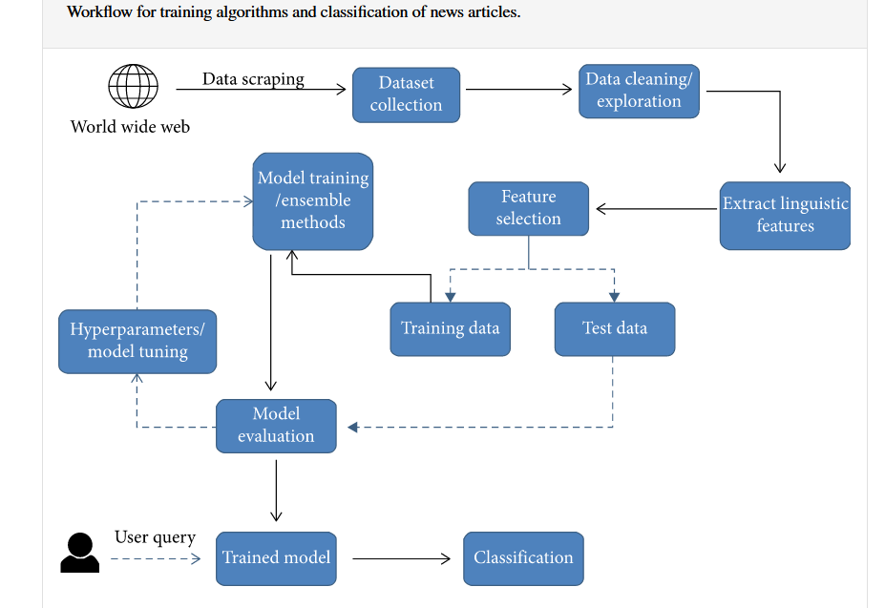
Implementation Plan

Slide 7
Dataset Preparation
The custom dataset created using various sources such as Mendeley, GitHub, and Kaggle provides a diverse collection of labeled news articles, offering an opportunity to explore different types and contexts of fake news.
Here mentioning the steps involved in Data preprocessing and Exploratory Data analysis
Data preprocessing steps completed:
For machine learning , it’s necessary to convert raw data into a clean data set. The below mentioned preprocessing steps which we completed for our dataset for preprocessing
Drop Columns That Aren’t Useful
Drop some of the columns which won't contribute much to our machine learning model. Here we dropped the column ‘id’

Slide 8
Handling missing data
Dealing with missing data is a common and inherent issue in data collection, especially when working with large datasets. If missing values have been found, there are particularly two ways to resolve this issue:
Either Remove the entire row that contains a missing value. However, removing the entire row can generate a possibility of losing some important data. This approach is useful if the dataset is very large Or Estimate the value by taking the mean, median or mode.
Here in our dataset, we mainly filled the missed data by taking either mean or mode
Dropping duplicate rows
Once we have identified duplicates in the dataset, it is time to remove them. To delete duplicates, we use a function drop_duplicates in Pandas

Slide 9
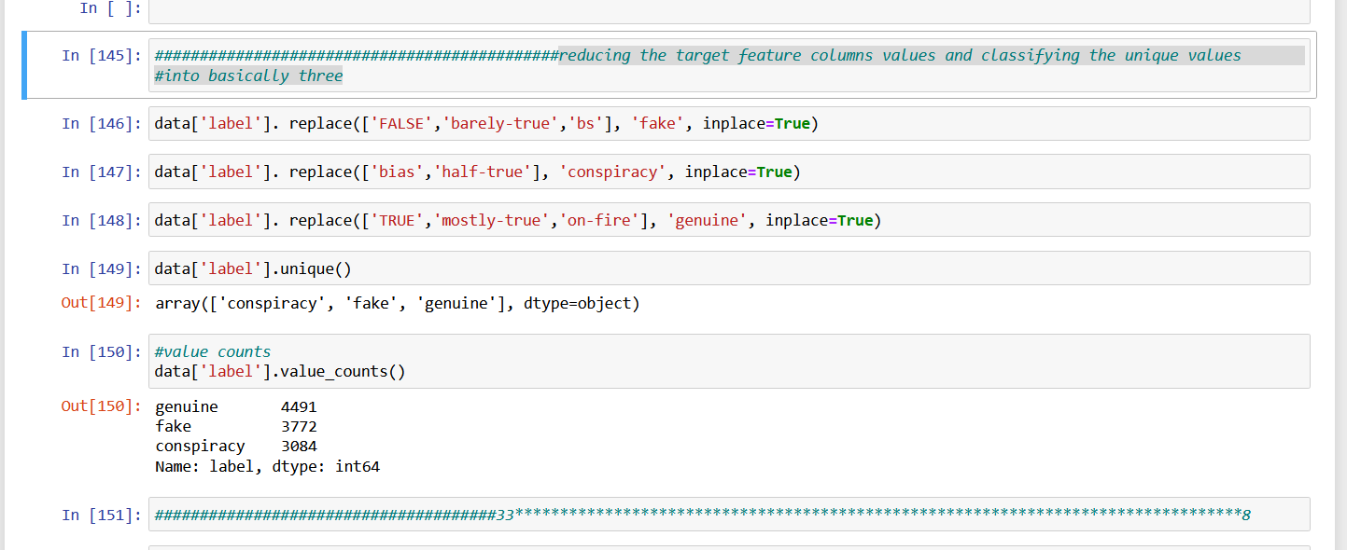
Data Transformation
Data transformation involves converting the data from one form to another to make it more suitable for analysis. Techniques such as normalization, scaling, or encoding can be used to transform the data. Here we scaled our target variable to desired values by reducing the target feature columns values and classifying it into basically three unique values as shown below:

Slide 10
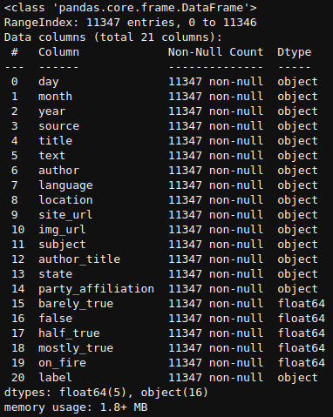
Exploratory Data Analysis
The cleaned dataset contains 20 columns including both feature sets and a target column, and the dataset contains more than 13,000 rows. The columns are day, month, year, source, title, text, author, language, location, site_url, img_url, subject, author_title, state, party_affiliation, barely_true, false, half_true, mostly_true, on_fire and label.

Slide 11
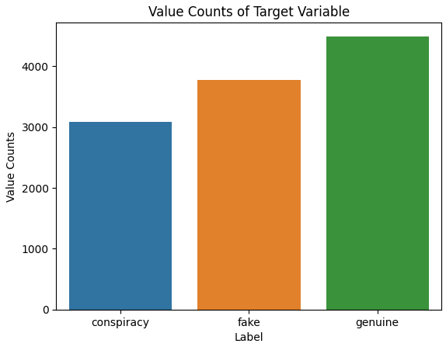
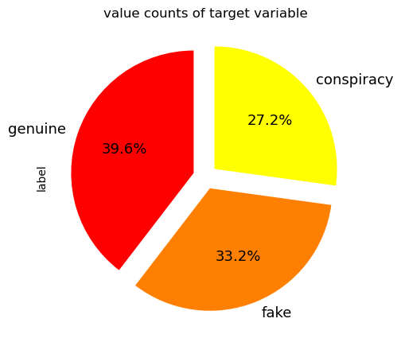
Plotting target column label using countplot and pie plot
The target column of our dataset contains only three unique values, which are genuine, fake and conspiracy. The plot shows the unique values in the target column plotted against their individual counts using seaborn’s countplot. And data values in the target columns are conspiracy, fake and genuine; and their counts are 4491, 3772 and 3084 respectively, and the percentage values are 27.2, 33.2 and 39.6 respectively.

